Slide 1

LEVERAGING MULTIOMICS DATA FOR PERSONALIZED LUNG CANCER PROGNOSIS THROUGH INTEGRATED HEALTH PROFILES
24-25J-211
NSCLC360
Project ID: 24-25J-211

Slide 2


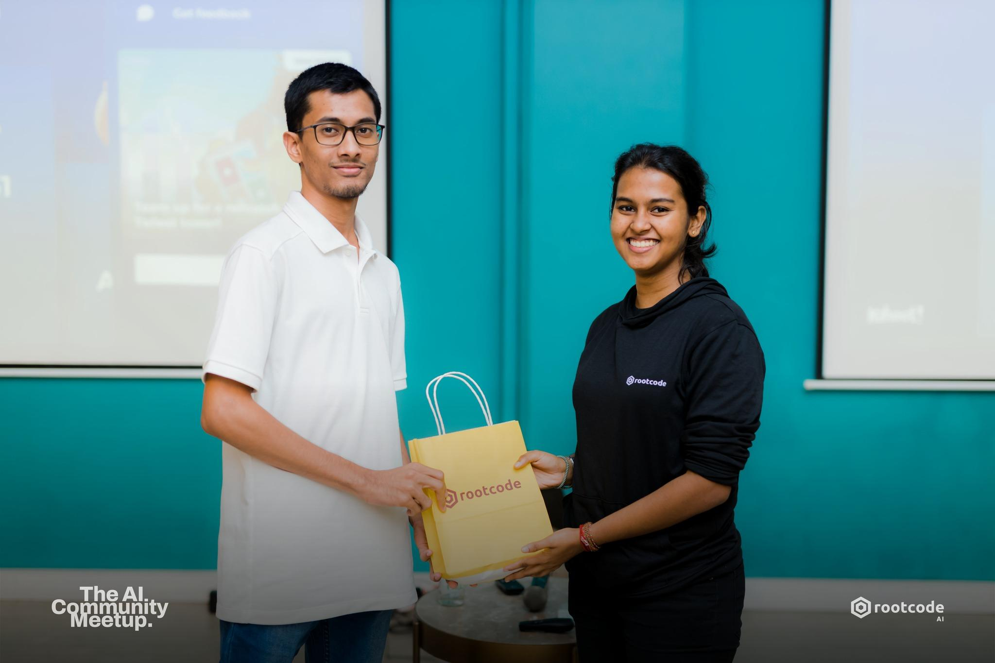




Waseek M.L
IT21374524
Arudchayan P
IT21190698
Irfan N.A.A
IT21331022
AHAMED A.S.S
IT2342226
Dr. Nuradh Joseph
External Supervisor
Mr. Samadhi Rathnayake Supervisor
Ms.Thisara Shyamalee
Co-Supervisor
Project ID: 24-25J-211
2024/12/06

Slide 3
INTRODUCTION
RESEARCH ǪUESTION
SYSTEM DIAGRAM
COMPONENTS
Project ID: 24-25J-211

Slide 4
Introduction
What is Prognosis?
Prognosis refers the understanding of a likely course and outcome of a disease based on the current health status, disease characteristics and response to treatment.
What is NSCLC?
Non-Small Cell Lung Cancer (NSCLC) is a particularly deadly form of lung cancer, primarily because it often remains asymptomatic until it has reached an advanced stage. The treatment options for NSCLC vary based on the stage of the cancer and the individual characteristics of the patient.
Project ID: 24-25J-211

Slide 5
Research Ǫuestions?
How can multimodal machine learning models improve early lung cancer detection and treatment while ensuring medical data privacy?
How can a quantitative approach leveraging omics data enhance prognostic analysis in non-small cell lung cancer?
How can we accurately predict NSCLC side effects using patient-specific data and advanced modeling to optimize treatment outcomes?
How can deep learning models predict NSCLC recurrence by integrating imaging, genomic, proteomic, and clinical data?
Project ID: 24-25J-211

Slide 6
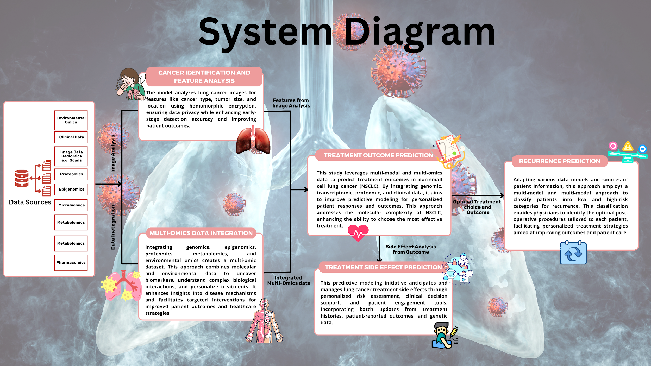
Project ID: 24-25J-211

Slide 7
IT21374524 | WASEEK M.L.
BSc (Hons) Information Technology Specializing in Data Science Secure
Advanced Deep Learning for Early Lung Cancer Detection and Feature Extraction
IT21374524 | Waseek M.L.
Project ID: 24-25J-211
2024/12/06

Slide 8
Research Ǫuestion
How can advanced machine learning models, through multimodal analysis and data integration, improve the early detection and treatment of lung cancer while ensuring the privacy of medical data?
IT21374524 | Waseek M.L.
2024/12/06

Slide 9
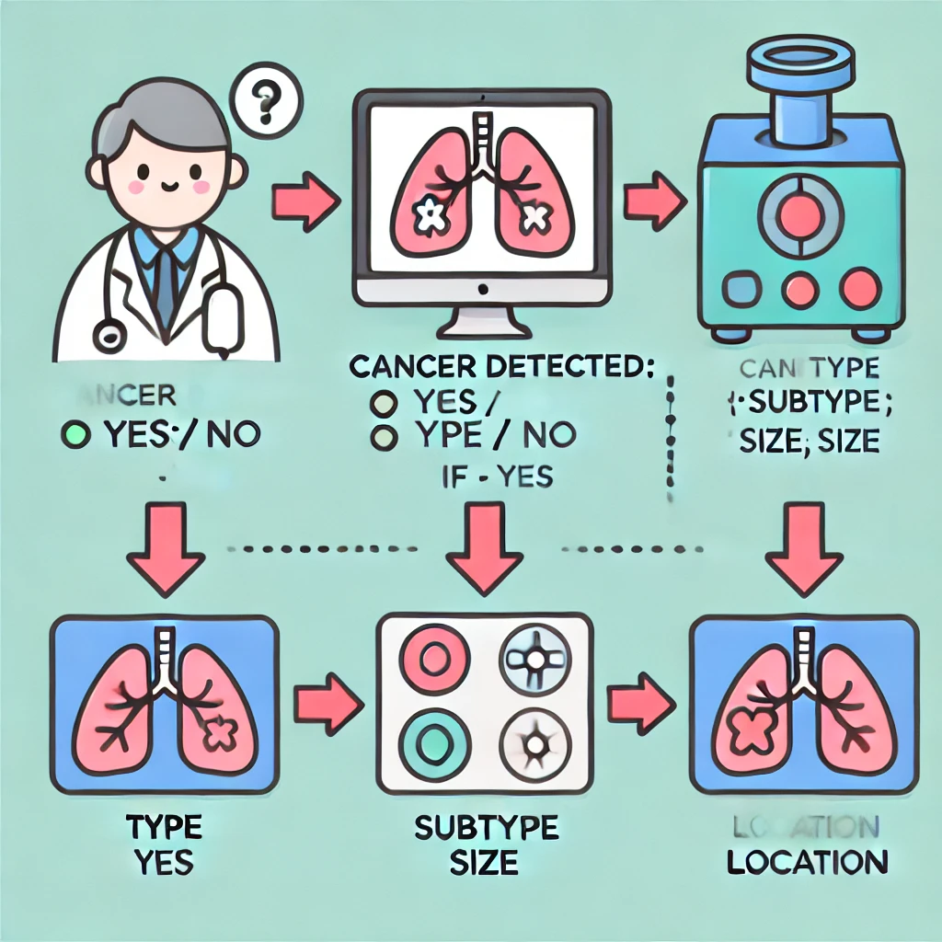
Cancer Detection and Feature Extraction Workflow

Slide 10
Specific Sub-Objectives
Design a model to classify NSCLC features from multimodal
imaging data
Optimize the model to enhance NSCLC detection accuracy by reducing false positives and negatives.
Integrate homomorphic encryption to secure medical data while preserving the model's accuracy.
IT21374524 | Waseek M.L.
2024/12/06

Slide 11
Data Set
Dataset obtained from The Cancer Imaging Archive (TCIA), which provides open-access medical imaging datasets.
Contains DICOM images with tumor-related features like size, location, and pathological staging (T, N, M).
Accessed directly from TCIA’s website without using the NBIA Data Retriever.
Includes thousands of records with imaging data like CT and PET scans.
Preprocessed to extract features, anonymize data, and prepare it for analysis.
Used to train a model for predicting cancer type, subtype, tumor size, location, and pathological staging.
TCIA and contributing researchers acknowledged for providing the dataset.

Slide 12
Data Pre Processing
DICOM File Conversion and Feature Extraction: Extracted key features like tumor size, location, and pathological stages (T, N, M) using tools like pydicom while retaining metadata.
Anonymization: Removed patient-identifiable information from DICOM headers to ensure compliance with privacy regulations.
Image Normalization and Augmentation: Standardized image intensity and applied transformations (e.g., rotation, scaling) to enhance dataset diversity.
Data Splitting: Divided data into training, validation, and testing sets for unbiased model evaluation.

Slide 13
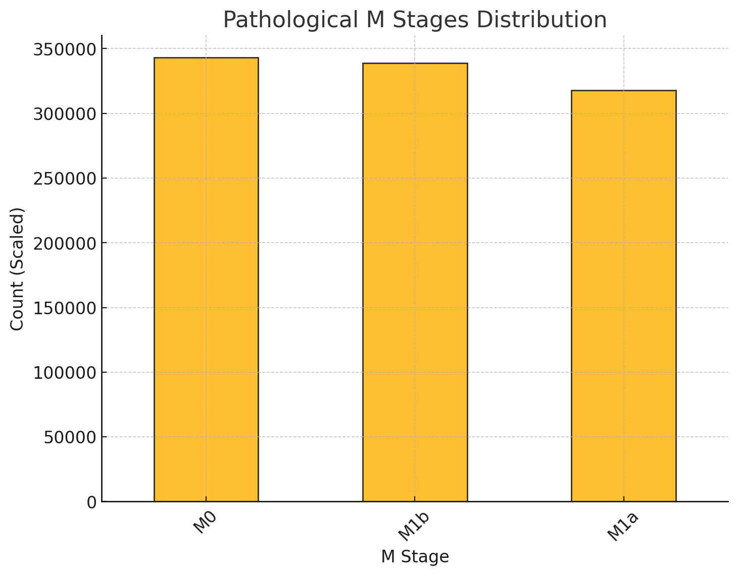
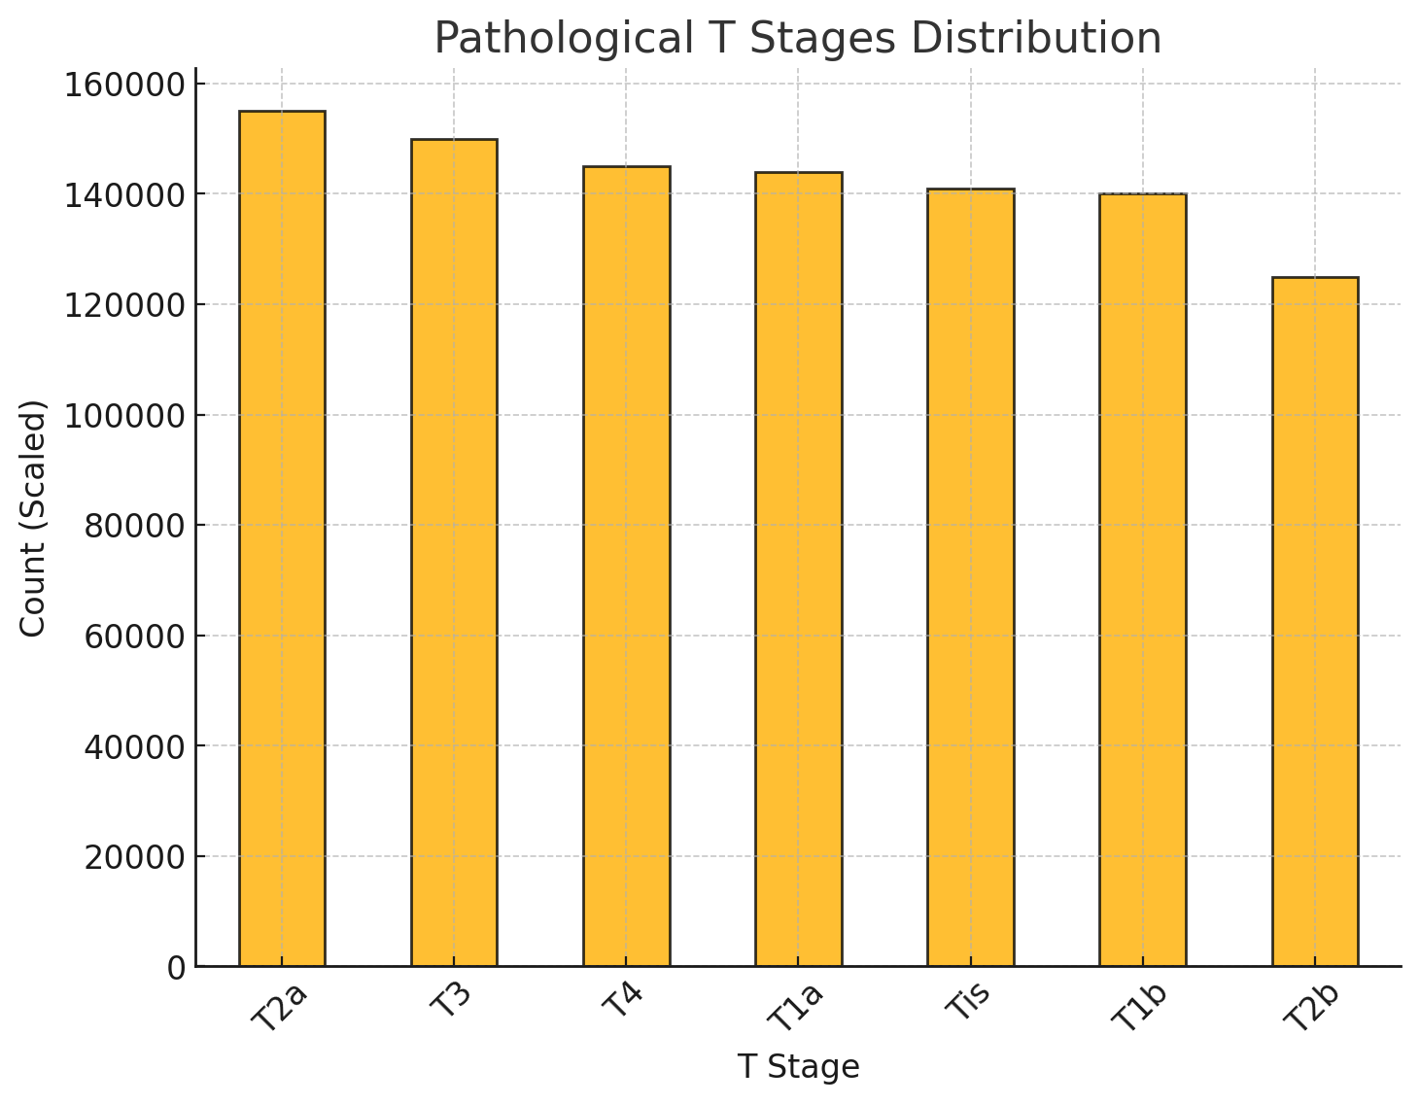
Data Distribution

Slide 14
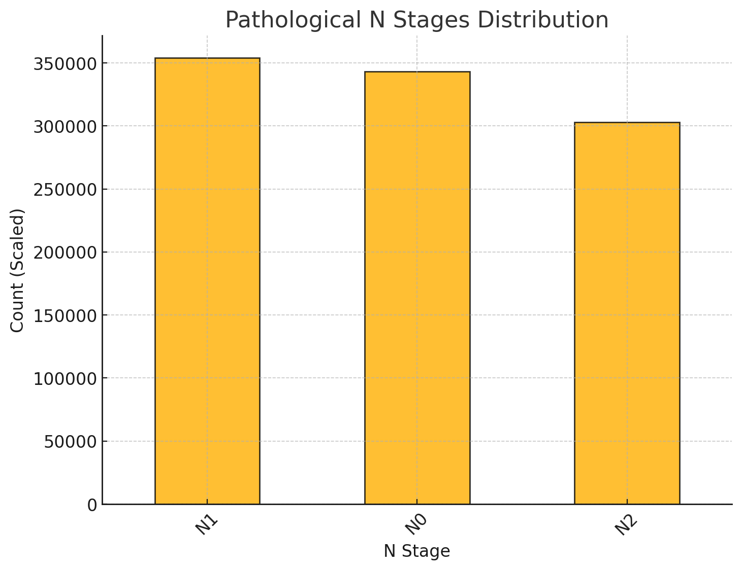
Data Distribution

Slide 15
Challenges
Processing and training on large DICOM datasets demanded significant computational resources, including high-end GPUs/TPUs, which were not always readily available.
Training deep learning models on such large and complex datasets took a considerable amount of time, often requiring hours or even days to complete.
Fine-tuning the model to achieve satisfactory accuracy was challenging, requiring extensive hyperparameter optimization and experimentation.
Handling and preprocessing a large volume of DICOM files while ensuring data integrity and consistency added to the complexity.

Slide 16
References
Nam, J. G., Kim, J. E., Yoon, S. H., Lee, S., Kim, N. H., Kim, H. Y., ... & Goo, J. M. (2021). Lung cancer screening with deep learning: The DLAD system. Radiology.
B. Lambin, P., Rios-Velazquez, E., Leijenaar, R., Carvalho, S., van Stiphout, R. G., Granton, P., ... & Dekker, A. (2012). Radiomics: The bridge between medical imaging and personalized medicine. Nature Reviews Clinical Oncology, 9(12), 749-762.
C. Ardila, D., Kiraly, A. P., Bharadwaj, S., Choi, B., Reicher, J. J., Peng, L., ... & Shetty, S. (2019). Artificial intelligence in lung cancer diagnosis: Challenges and opportunities. Nature Medicine, 25(6), 1019-1025.
D. Hesamifard, E., Takabi, H., Ghasemi, M., & Jones, C. (2017). Privacy-preserving machine learning as a service using homomorphic encryption. Proceedings of the 2017 ACM Workshop on Artificial Intelligence and Security, 36-45.
IT21374524| Waseek M.L.
Project ID: 24-25J-211
2024/12/06

Slide 17


Research Gap
Aspect Research | Deep Learning for Lung Cancer Detection | Feature Extraction in Lung Cancer | Homomorphic Encryption in Healthcare | AI Integration in Lung Cancer Detection | NSCLC 360
Research A
Research B
Research C
Research D
IT21374524 | Waseek M.L.
2024/12/06

Slide 18

Methodology – Technologies & Techniques
Technologies
Techniques
Python language
Python libraries
Tensorflow
VS Code
Dicom Image viewer
Machine Learning
Deep Learning
Optimization
IT21374524 | Waseek M.L.

Slide 19
IT21190698 | Arudchayan P.
BSc (Hons) Information Technology Specializing in Data Science Secure
A Novel Explainable Approach for Enhancing Prognostic Analysis in Non-Small Cell Lung Cancer
IT21190698 P Arudchayan
Project ID: 24-25J-211
2024/12/06

Slide 20
Research Ǫuestion
How can a novel explainable approach leveraging omics data enhance prognostic analysis in non-small cell lung cancer?
IT21190698 P Arudchayan
Project ID: 24-25J-211
2024/12/06

Slide 21
Specific Sub-Objectives
Identifying Potential Prognostic Biomarkers
Validating the multicohort - generalizability
Creating a Prognostic Model
IT21190698 P Arudchayan
Project ID: 24-25J-211
2024/12/06

Slide 22
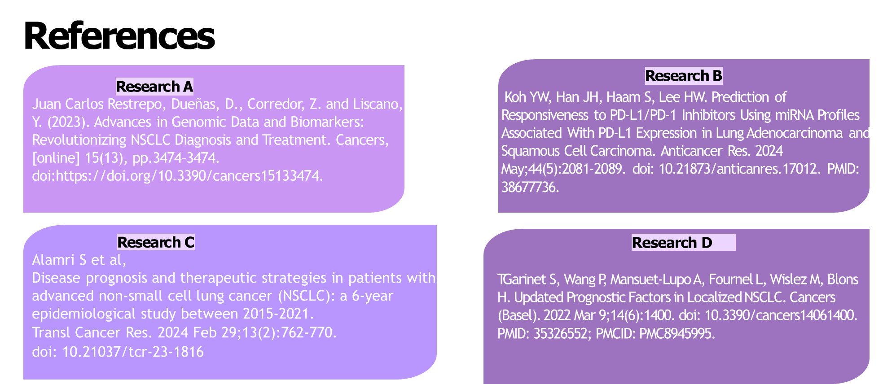
IT21190698 P Arudchayan
Project ID: 24-25J-211
2024/12/06

Slide 23
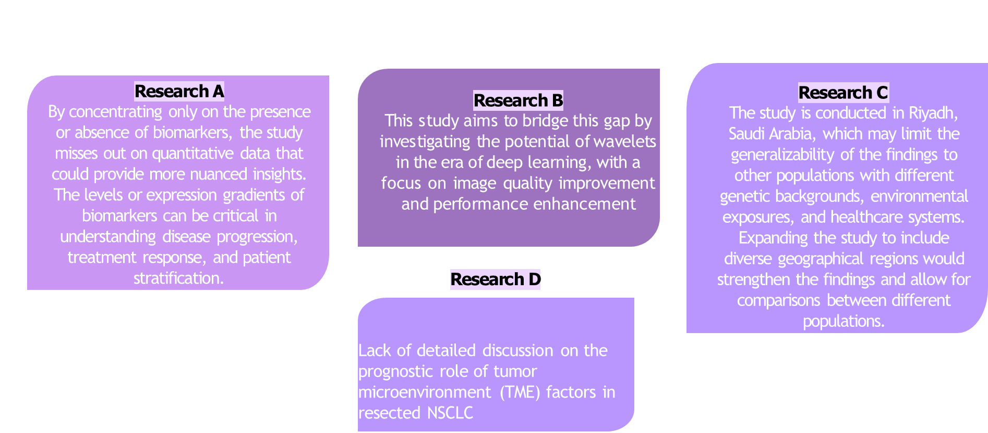
Research B
This study focuses on a single biomarker’s expression, rather than a holistic approach looking at multiple biomarkers
IT21190698 P Arudchayan
Project ID: 24-25J-211
2024/12/06

Slide 24

Research Gap
Aspect Research | Improved Outcomes | Data Bias | Optimization | Black Box Nature
Research A
Research B
Research C
Research D
IT21190698 P Arudchayan
Project ID: 24-25J-211
2024/12/06

Slide 25
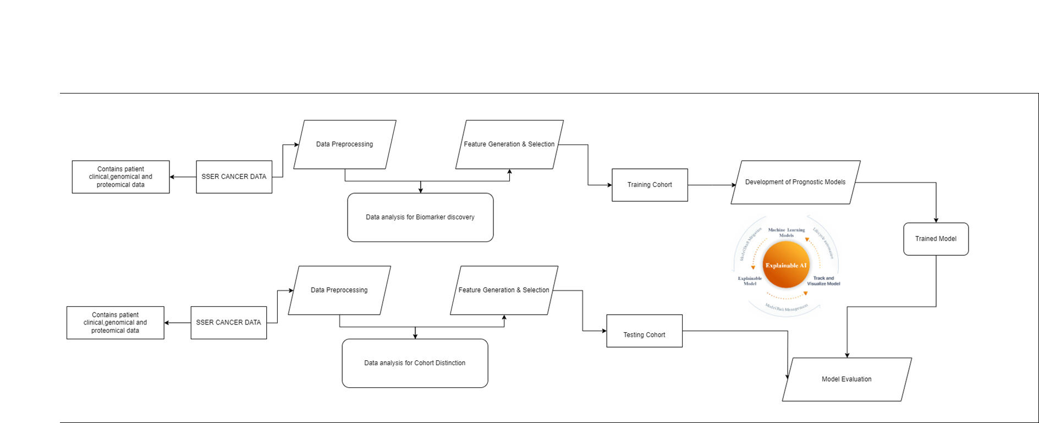
IT21190698 P Arudchayan
Project ID: 24-25J-211
2024/12/06

Slide 26
Methodology – Technologies & Techniques
Technologies
Techniques
Python
NumPy
Tenserflow
Weights&Biases
Google Colab
Machine Learning
Deep Learning
Explainable AI
Optimization
IT21190698 P Arudchayan
Project ID: 24-25J-211
2024/12/06

Slide 27
Survival Prediction
Histological Imaging: Histological imaging involves examining tissue samples under a microscope to study cellular structures and compositions. It uses staining techniques to visualize tissue components. This method helps identify abnormalities, such as cancerous cells. It provides vital information for diagnosis and treatment.
Somatic Mutation: A somatic mutation occurs in the DNA of somatic cells during an individual’s lifetime and is not inherited. These mutations can result from environmental factors or DNA replication errors. Somatic mutations play a crucial role in cancer development. They can lead to uncontrolled cell division and tumor growth.
RNA: RNA is a single-stranded molecule that plays a key role in gene expression and protein synthesis. It includes various forms such as mRNA, tRNA, and rRNA. mRNA serves as the template for translating genetic information into proteins. Studying RNA provides insight into gene regulation and disease mechanisms.
Multiomics: Multiomics integrates multiple biological data types, such as genomics, proteomics, and transcriptomics, to analyze complex biological systems. This approach uncovers interactions between genes, proteins, and metabolites. It enables a comprehensive understanding of diseases. Multiomics aids in biomarker discovery and personalized medicine.

Slide 28
Major Data sets Used In Litriture
· Major Datasets used in Literature
o Surveillance, Epidemiology, and End Results (SEER)
o The Cancer Genome Atlas Program (TCGA) – Lung Adenocarcinoma 2014 (multiple available)
o The Cancer Imaging Archive | NSCLC-Radiomics
o BPC NSCLC 2.0-public
o Prostate, Lung, Colorectal and Ovarian (PLCO) Cancer Screening Trial Works done in literature

Slide 29
SEER
§ Lung Cancer Survivability Prediction with Recursive Feature Elimination using Random Forest and Ensemble Classifiers.
§ Prognostic analysis of patients with non-small cell lung cancer based on Bayesian network model
§ A Two-Step Machine Learning Model for Stage-Specific Disease Survivability Prediction
§ Effect of socioeconomic status on lung cancer survival: A mediation analysis based on Bayesian network approach

Slide 30
TCGA LUAD
Integrative Analysis of Pathological Images and Multi-Dimensional Genomic Data for Early-Stage Cancer Prognosis
Pathomic Fusion: An Integrated Framework for Fusing Histopathology and Genomic Features for Cancer Diagnosis and Prognosis
Relation-Aware Shared Representation Learning for Cancer Prognosis Analysis With Auxiliary Clinical Variables and Incomplete Multi-Modality Data
Multi-Constraint Latent Representation Learning for Prognosis Analysis Using Multi-Modal Data
Differentially Expressed Mutant Genes Reveal Potential Prognostic Markers For Lung Adenocarcinoma

Slide 31
NSCLC Radiomics
Fusion of Quantitative Image and Genomic Biomarkers to Improve Prognosis Assessment of Early Stage Lung Cancer Patients
Improved Genotype-Guided Deep Radiomics Signatures for Recurrence Prediction of Non-Small Cell Lung Cancer
Association between tumor heterogeneity and overall survival in patients with non-small cell lung cancer

Slide 32
BPC NSCLC
Insights into treatment-specific prognostic somatic mutations in NSCLC from the AACR NSCLC GENIE BPC cohort analysis
EP07.05-15 Prognostic Factors in Non-Small-Cell Lung Cancer Treated with Chemoimmunotherapy or Chemotherapy: A Real-World Data Study

Slide 33
PLCO
Detection method has independent prognostic significance in the PLCO lung screening trial
Lung cancer screening in the randomized Prostate, Lung, Colorectal, and Ovarian (PLCO) Cancer Screening Trial
Lung cancer prognostic index: a risk score to predict overall survival after the diagnosis of non-small-cell lung cancer

Slide 34
Explainable Approaches
An Interpretable Approach for Lung Cancer Prediction and Subtype Classification using Gene Expression
Guaranteeing Correctness in Black-Box Machine Learning: A Fusion of Explainable AI and Formal Methods for Healthcare Decision-Making
Unveiling Genetic Disorders: Machine Learning and Deep Learning Approaches in Gene Expression Analysis

Slide 35
Major Approaches
§ Classifying into Survival Category
§ Predicting Overall Survival Months

Slide 36
Major Models Used
§ Logistic Regression (Hazra et al 2017)(Wang et al 2021)
§ Support Vector Machine (Hazra et al 2017)
§ Naïve Bayes,Gaussian K based,(Kaviarasi et al 2019)
§ Bayesian Network Model (Karthika et al 2017) (C. Yu-Rong et al 2022)
§ SHapley Additive exPlanations (Bernado et al 2021) (Nadia et al 2024)
§ Local Interpretable Model-Agnostic Explanations (Nadia et al 2024)
§ DeepLIFT (Deep Learning Important FeaTures) (Kountay Dwivedi et al 2023)

Slide 37
Challenges Faced
§ Datasets are all different and diverse, requiring significant knowledge on preparation.
§ Most detailed research are done on locked datasets.
§ Most datasets are not natively multi-omic
§ Most research derive results and conclusions not purely from data but bio knowledge of researcher.
§ Need for very high levels of data study.
§ Need for very high levels of experimentation.
§ Need for a common framework.

Slide 38
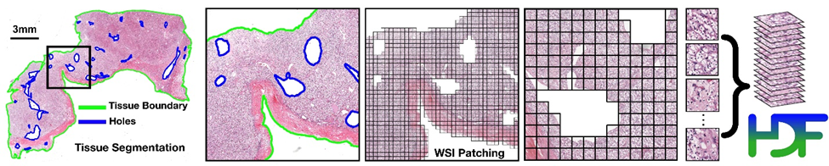
Potential Solutions
Whole Slide Images Analysis – CLAM Framework

Slide 39
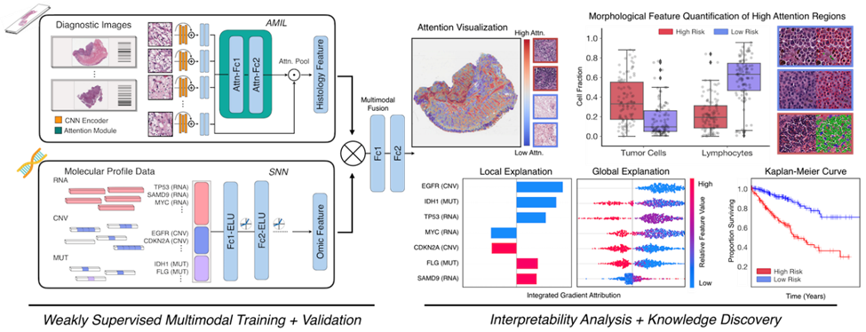
Potential Solutions
§ PORPOISE FRAMEWORK FOR TCGA

Slide 40
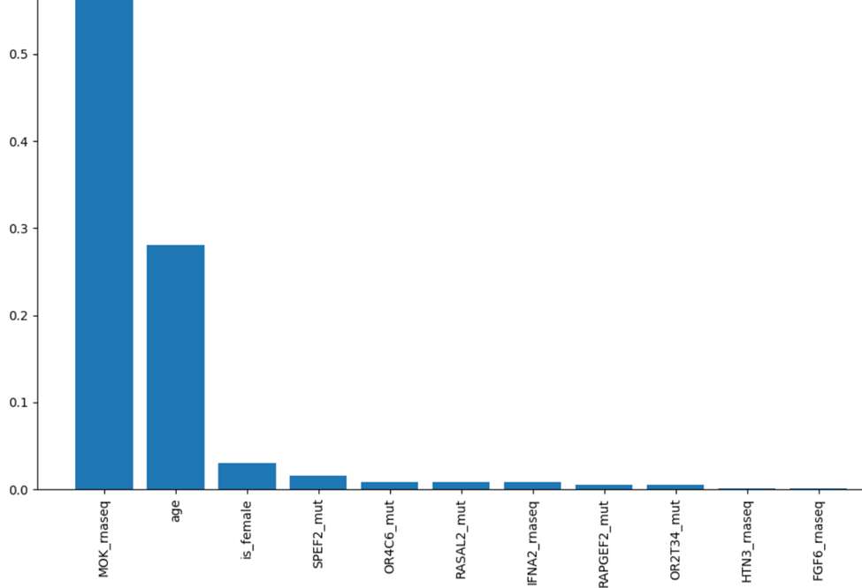
Findings - TCGA

Slide 41
Next Steps
§ Evaluate BioMarkers available (TCGA,BPC).
§ Evaluate Clinical factors (SEER,TCGA,BPC,PLCO).
§ Evaluate Explainability.
§ Evaluate cross cohort relationships/generalizability.
§ Create Generalizability

Slide 42
IT2342226 | AHAMED A.S.S
BSc (Hons) Information Technology Specializing in Data Science Secure
Machine learning for Non-Small Cell Lung Cancer complication Prediction
IT21342226 | Ahamed A.S.S
Project ID: 24-25J-211
2024/12/06

Slide 43
Research Question
How can we accurately predict Complication in lung cancer (LC) leveraging patient and treatment specific data and modeling techniques, to optimize treatment strategies and improve overall patient outcomes?
IT21342226 | Ahamed A.S.S
Project ID: 24-25J-211
2024/12/06
IT21342226 | Ahamed A.S.S
2024/12/06

Slide 44
Challenges
Identifying a suitable dataset that matches the component topic
Preprocessing the medical dataset with careful medical knowledge
Identifying a suitable model and making the prediction
IT21342226 | Ahamed A.S.S
Project ID: 24-25J-211
2024/12/06
IT21342226 | Ahamed A.S.S

Slide 45
Specific Sub-Objectives
To identify key factors influencing Complication through feature engineering and analysis.
Enhance the of Complication prediction with the potential Data collected ….
Enhance the built machine learning models
IT21342226 | Ahamed A.S.S
Project ID: 24-25J-211
2024/12/06
IT21342226 | Ahamed A.S.S

Slide 46

Methodology – Requirements
Expertise in data science, machine learning, and clinical research. Strong communication and collaboration skills to work effectively with medical professionals.
Accuracy
Scalability
Security
Performance
Usability
Data Collection
Model Training
Side effect prediction
User interface
Report generation
IT21190698 P AhamedA.S.S
Project ID: 24-25J-211
2024/12/06

Slide 47
Dataset and Techniques
A dataset was obtained from the PLCO Lung Dataset, along with its data dictionary. Accessing this dataset required a lengthy process.
Dataset was available with more tha 260 variables and above a 100 thousand rows. And it is cleaned and preproccsed to 20000 rows and 33 columns
Various preprocessing techniques are used. Like SMOTEEN for data balancing onehot encoding, data label encoding. Feature engineering are used.
Various models like Random forest classification, Xgboost, Decision tree are used and finally came up with more accurate model Random forest classification.
ITxxxxxxx
IT21342226 | Ahamed A.S.S
Project ID: 24-25J-211
2024/12/06

Slide 48
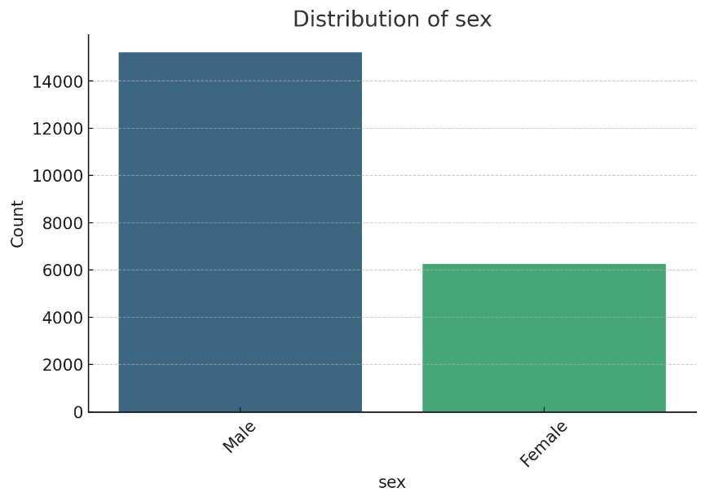
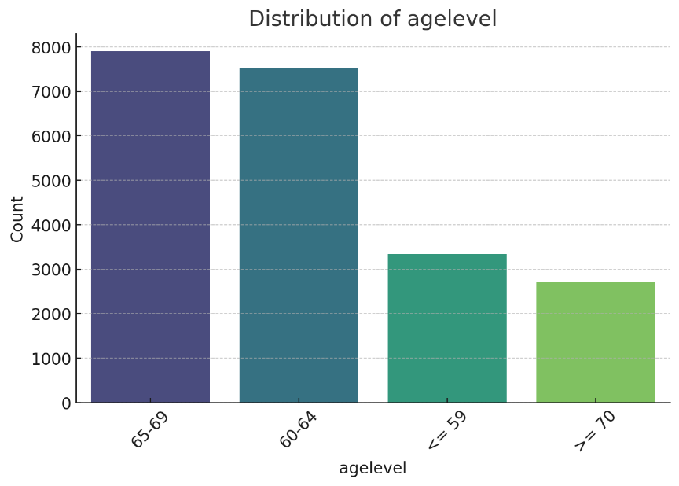
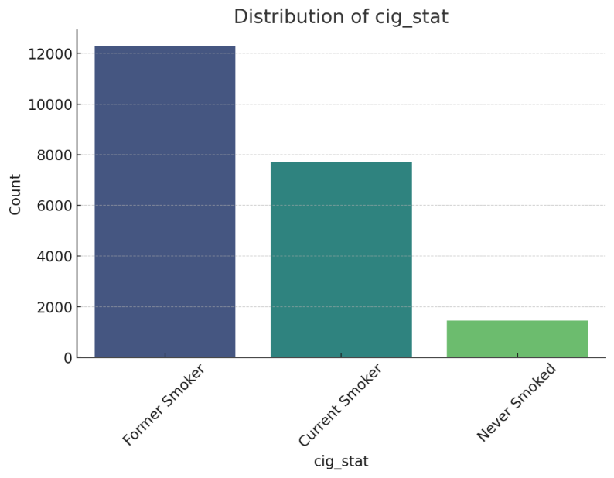
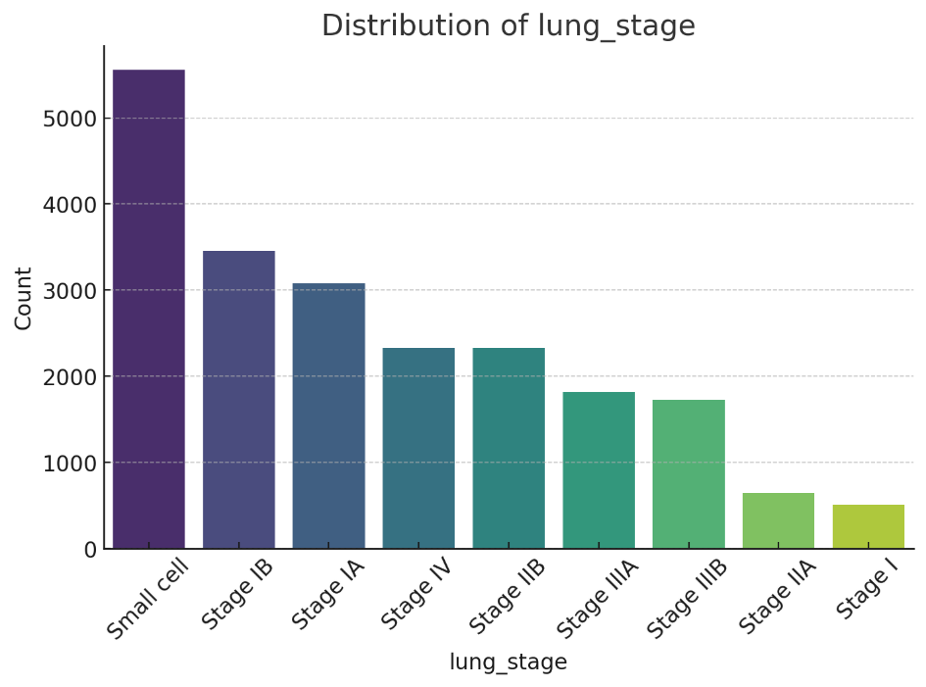
Data Visualization
IT21190698 P Arudchayan
Project ID: 24-25J-211
2024/12/06

Slide 49
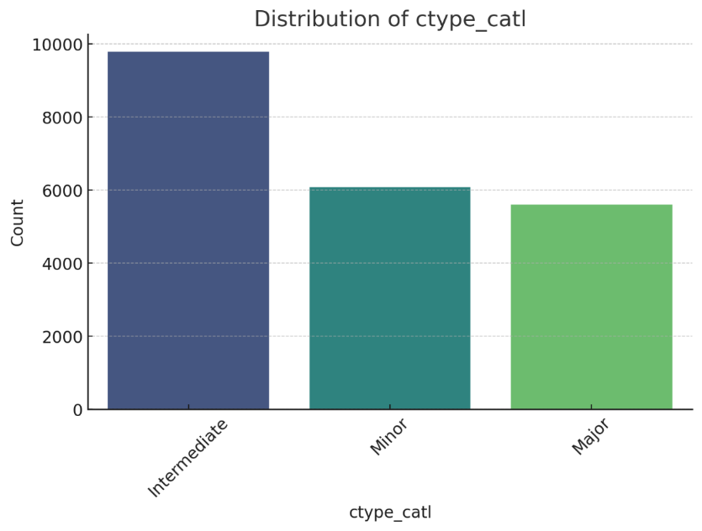
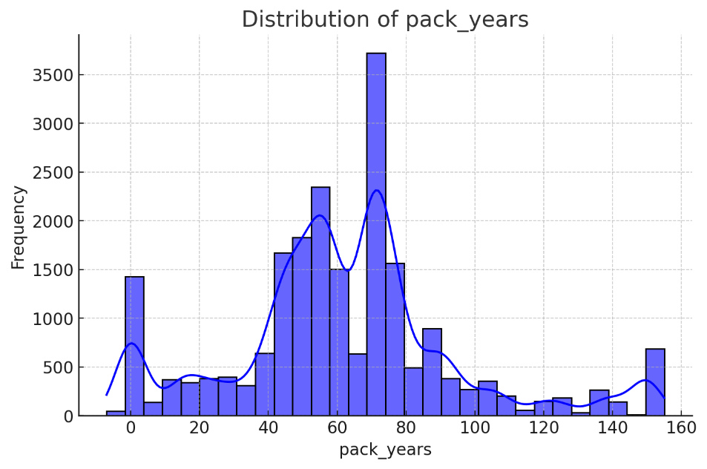
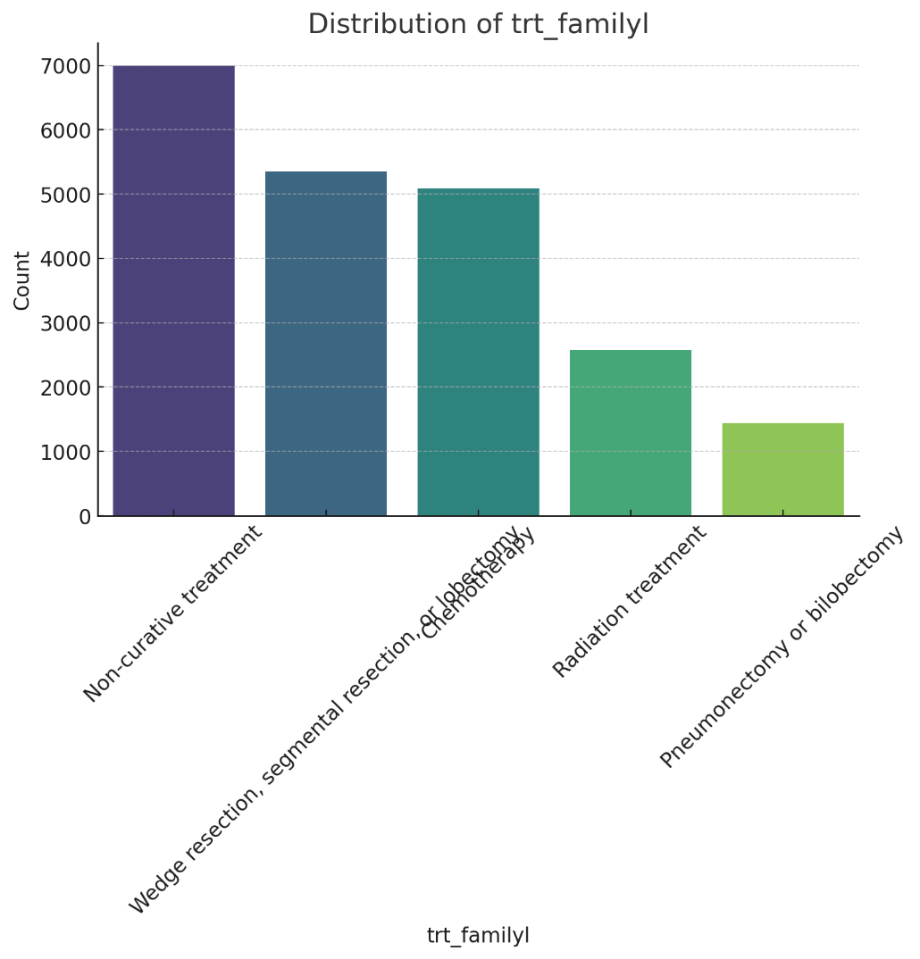
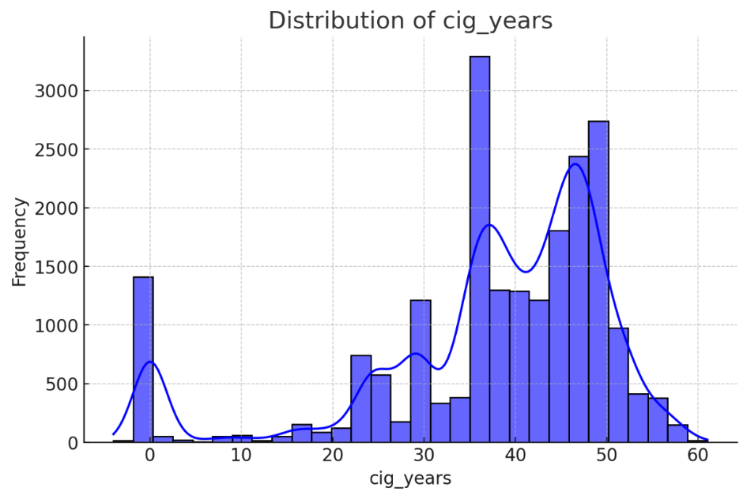
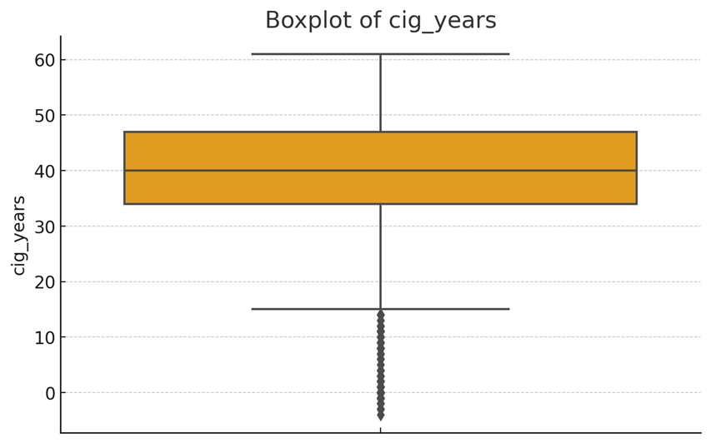
Data Visualization
IT21190698 P Arudchayan
Project ID: 24-25J-211
2024/12/06

Slide 50
Research Gap
Aspect Research | Lung Cancer Comp | Complications other cancer | Prediction of Severity of the Lung cancer | Lung Cancer complication gap | NSCLC 360
Identified compatible Dataset
Using Machine Learnig
Predicting Different Variables
Integrating Different Models
Integrating to Large System
ITxxxxxxx
IT21342226 | Ahamed A.S.S
Project ID: 24-25J-211
2024/12/06

Slide 51
Methodology – Technologies & Techniques
Technologies
Techniques
Python language
Python libraries
Tenserflow
VS Code
Google Colab
Machine Learning
Deep Learning
NLP
Optimization
ITxxxxxxx
IT21342226 | Ahamed A.S.S
Project ID: 24-25J-211
2024/12/06

Slide 52
References
Mazzocco, T., & Hussain, A. (2011). A side-effects mapping model in patients with lung, colorectal and breast cancer receiving chemotherapy. 2011 IEEE 13th International Conference on e-Health Networking, Applications and Services. This study provides valuable insights to medical and nursing staff for predicting chemotherapy side effects, enabling them to select appropriate interventions to minimize symptom impact.
Srinivas, T. A. S., Monika, M., Aparna, N., Narasimha Rao, C., & Ramprabhu, J. (2023). A Methodology to Predict the Lung Cancer and its Adverse Effects on Patients from an Advanced Correlation Analysis Method. 2023 International Conference on Intelligent Data Communication Technologies and Internet of Things.
Fletcher, C., Wilson, C. J., Hutchinson, A., & Grunfeld, E. (2018). The relationship between anticipated response and subsequent experience of cancer treatment-related side effects: A meta-analysis comparing effects before and after treatment exposure. Cancer Treatment Reviews.
IT21342226 | Ahamed A.S.S
Project ID: 24-25J-211
2024/12/06

Slide 53
IT21331022 | IRFAN N.A.A
BSc (Hons) Information Technology Specializing in Data Science Secure
Non-Small Cell Lung Cancer Recurrence Prediction and Stratification
IT21331022 Irfan N.A.A
Project ID: R24-071
2024/12/06

Slide 54
Research Ǫuestion
How to accurately predict the recurrence in non-small cell lung cancer (NSCLC) by developing advanced deep learning models that can extract key features from imaging data as well as genomic, proteomic and clinical data. And predict the time of cancer recurrence as well as the locality of recurrence.
IT21331022 Irfan N.A.A
Project ID: R24-071
2024/12/06

Slide 55
Specific Sub-Objectives
Identifying features for predicting recurrence of cancer location and time frame
Fusion Of Data of Multiple Modalities
Stratifying patients with cancer according to risk of relapse
IT21331022 Irfan N.A.A
Project ID: R24-071
2024/12/06

Slide 56
Necessary Data and Sources
Clinical Data
Radiomic Data
Genomic Data
Histopathological Data
The Prostate, Lung, Colorectal and Ovarian (PLCO) Databank
The cBioPortal for Cancer Genomics
TCGA database

Slide 57
Methodologies
Preprocessing multi omic datasets and training to specific ML models
Use separate models for each datasets, and use Feature fusion to combine the outputs with Aggregation.
Integrate datasets of varying modalities and use a multi model and multi modal approach

Slide 58
SVM
Linear Regression
Gradient Boosting
Cox Regression Hazard Model

Slide 59
Challenges and further improvements
Fusion of Multiple Datasets with multiple modalities
Prediction of recurrence location, time and possibility.
Stratifying patients with cancer according to risk of relapse
Multi Cohort Generalizability and explainability

Slide 60
THANK YOU
Project ID: R24-071
2024/12/06

